Slide 1

XHAW5112

Slide 2
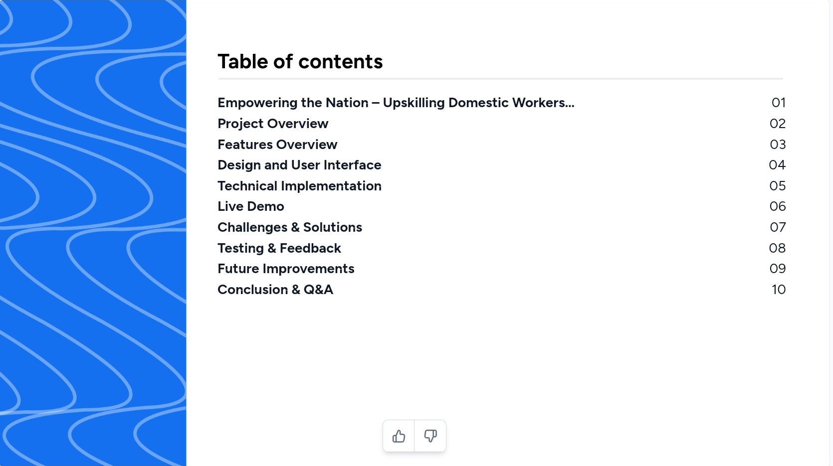







Table of contents
Empowering the Nation - Upskilling Domestic Workers...
Project Overview
Design and User Interface
Features Overview
Live Demo
Technical Implementation
Challenges & Solutions
Future Improvements
Conclusion & Q&A

Slide 3

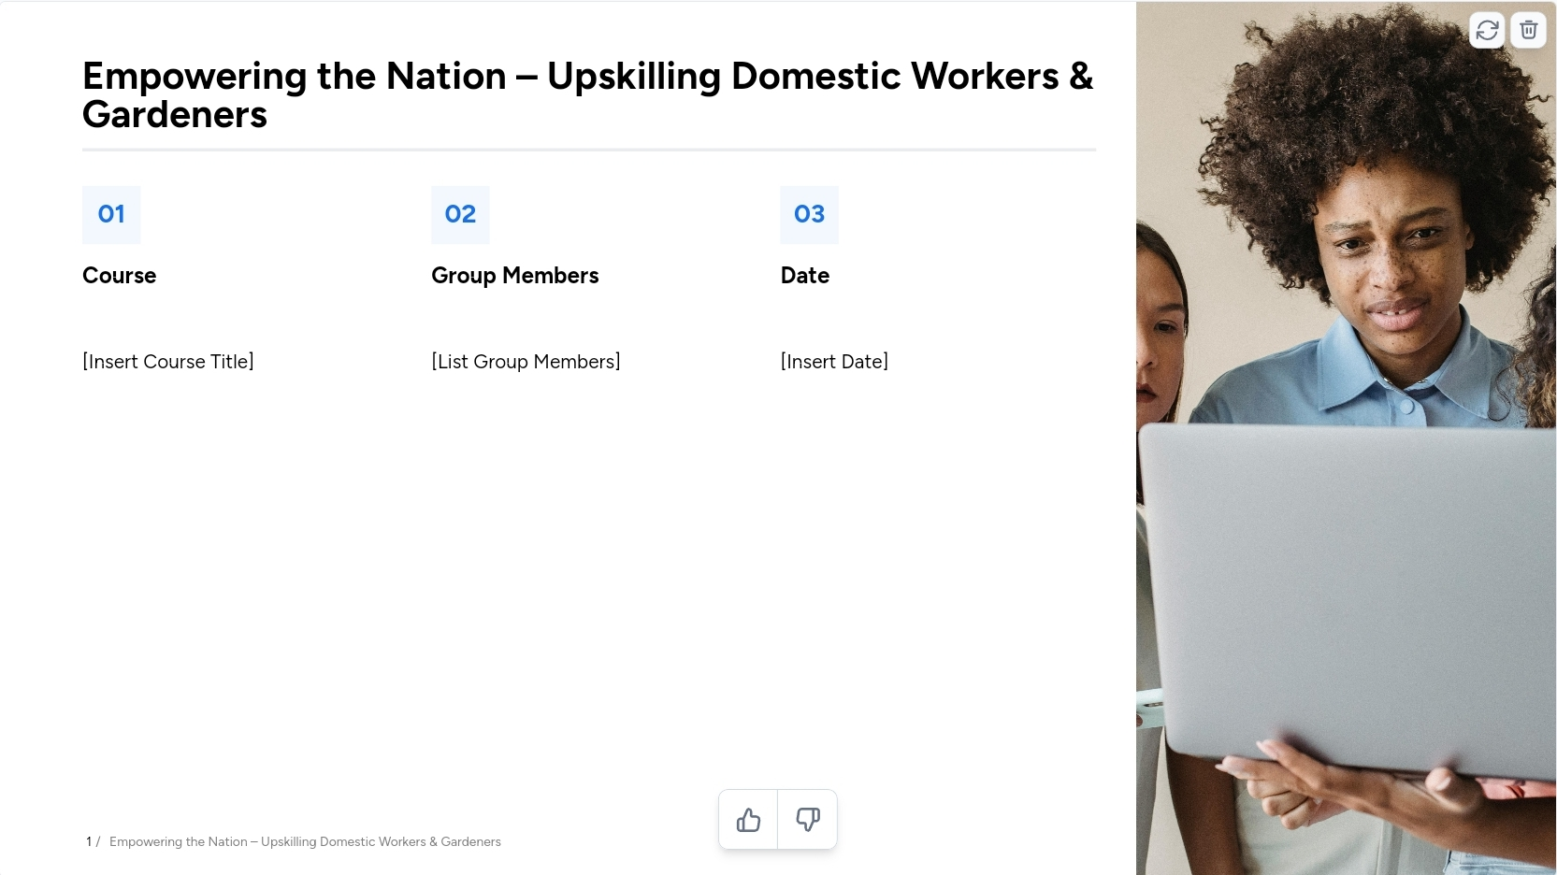





















Empowering the Nation – Upskilling Domestic Workers & Gardeners
01
02
03
Course
Group Members
Student Number
XHAW5112
David Sadiki
Lwamnkelo Saunders
Britney Reginald
st10436117
st10445173
st10438790

Slide 4
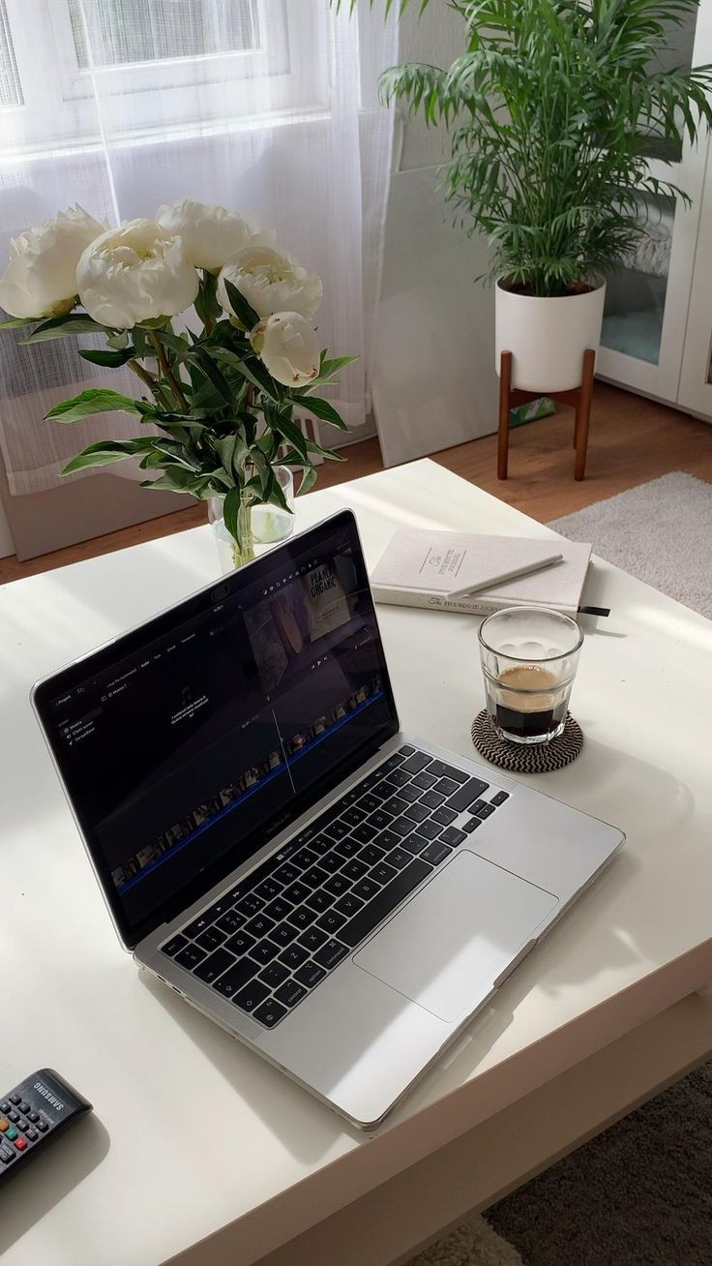
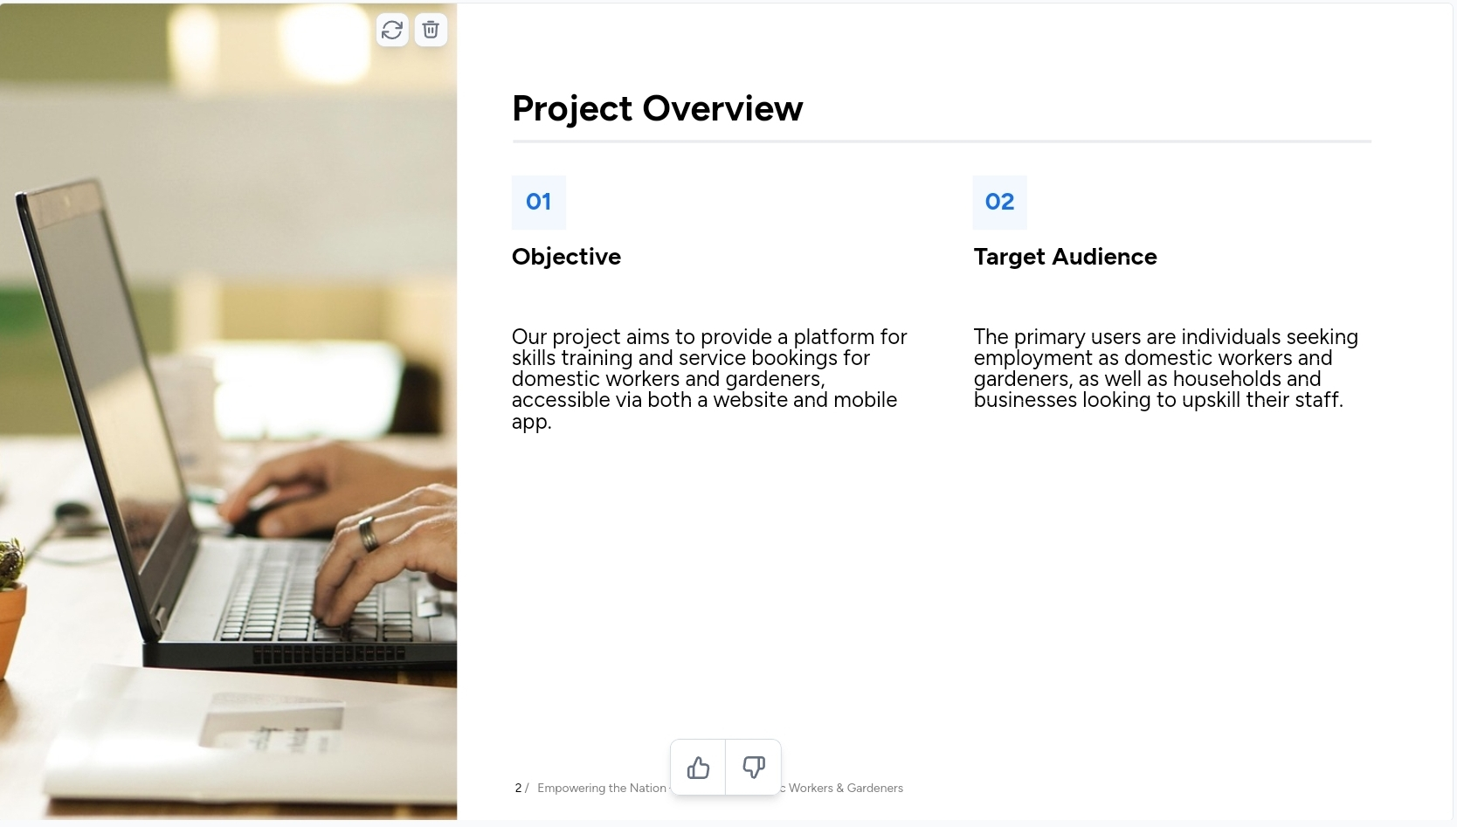





Project Overview
01
02
Objective
Target Audience
Our project aims to provide a platform for skills training and service bookings for domestic workers and gardeners, accessible via both a website and mobile app.
The primary users are individuals seeking employment as domestic workers and gardeners, as well as households and businesses looking to upskill their staff.

Slide 5
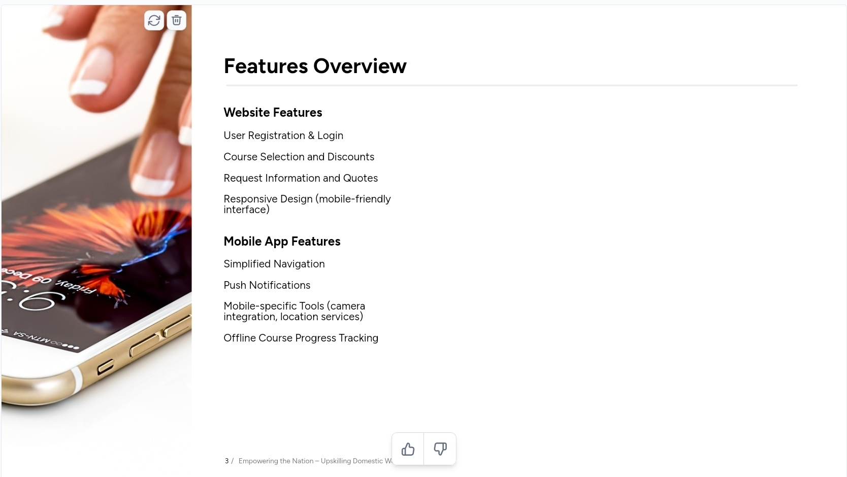
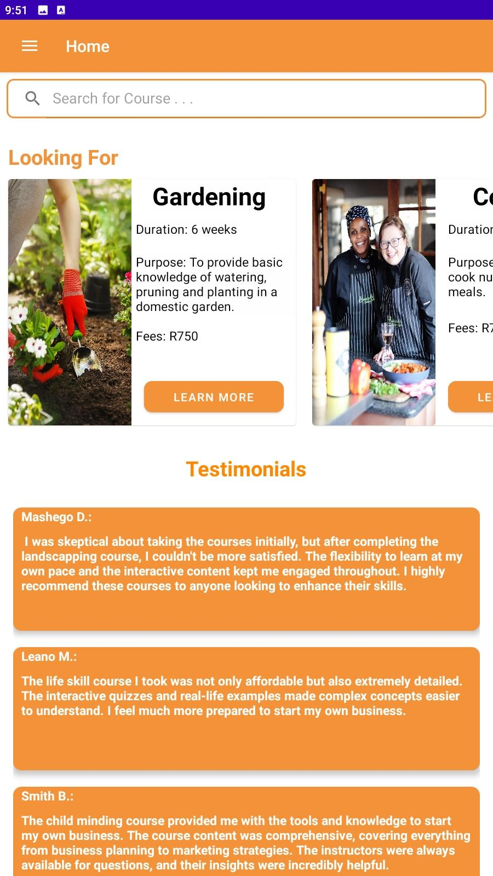
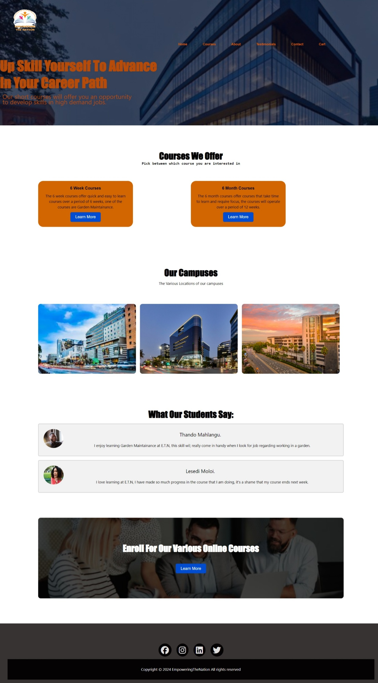










Mobile App
Mobile App Features
Simplified Navigation
Mobile-specific Tools (camera integration, location services)
Offline Course Progress Track
Website Features
Course Selection and Discounts
Request Information and Quotes
Responsive Design (mobile-friendly interface)
Website

Slide 6
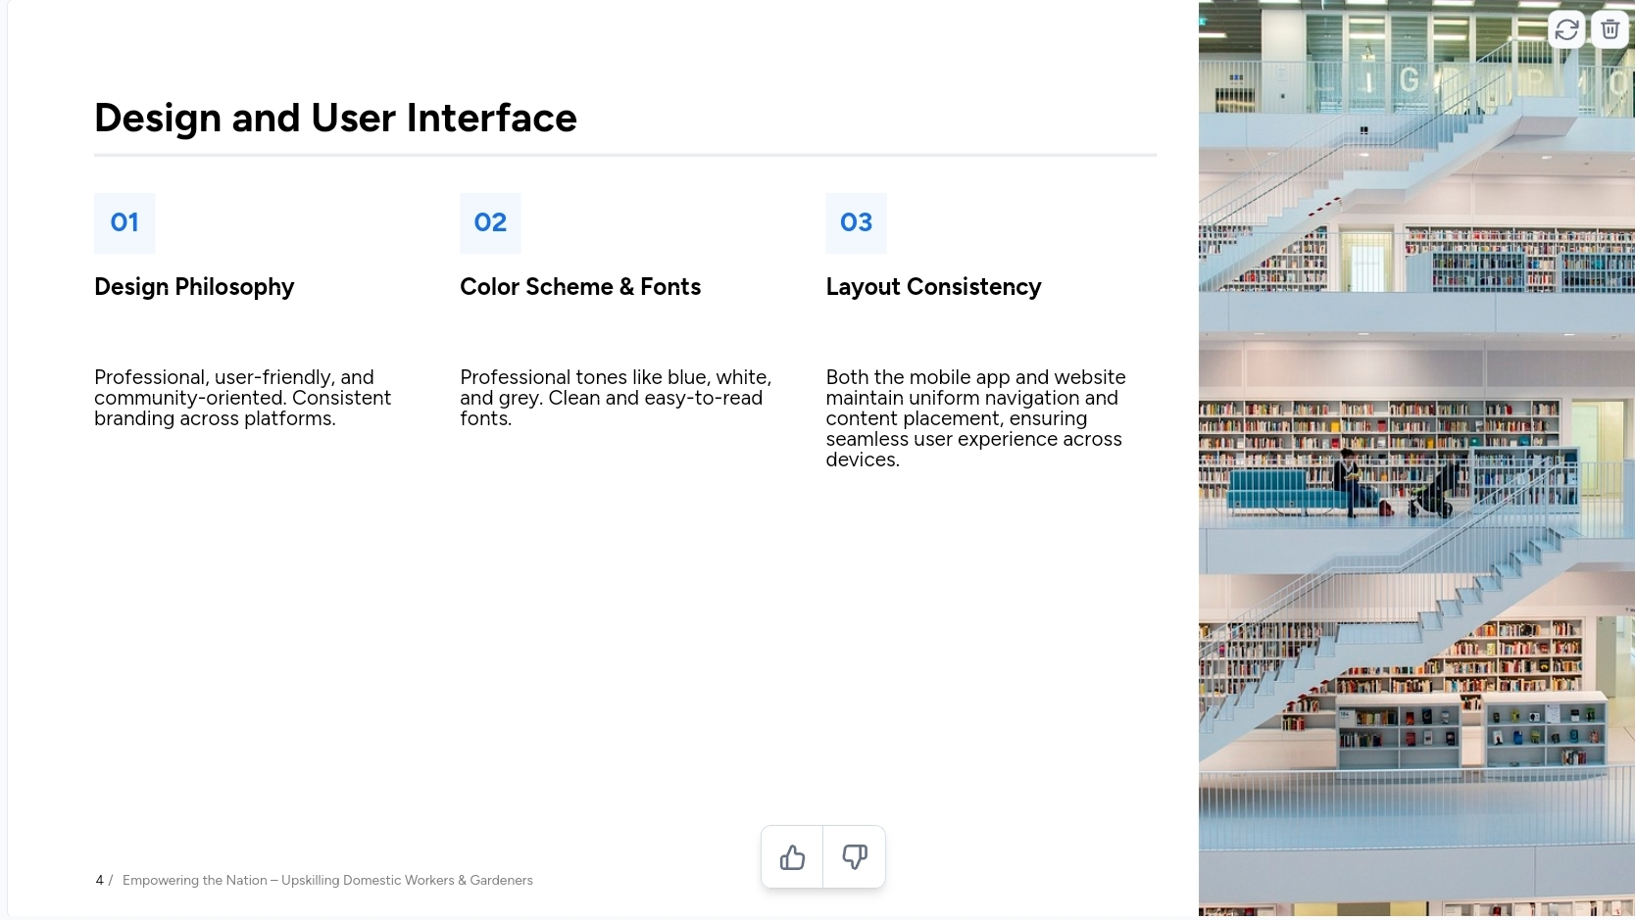




01
02
03
Professional tones such as orange, white and blue. Clean and easy-to-read fonts.

Slide 7
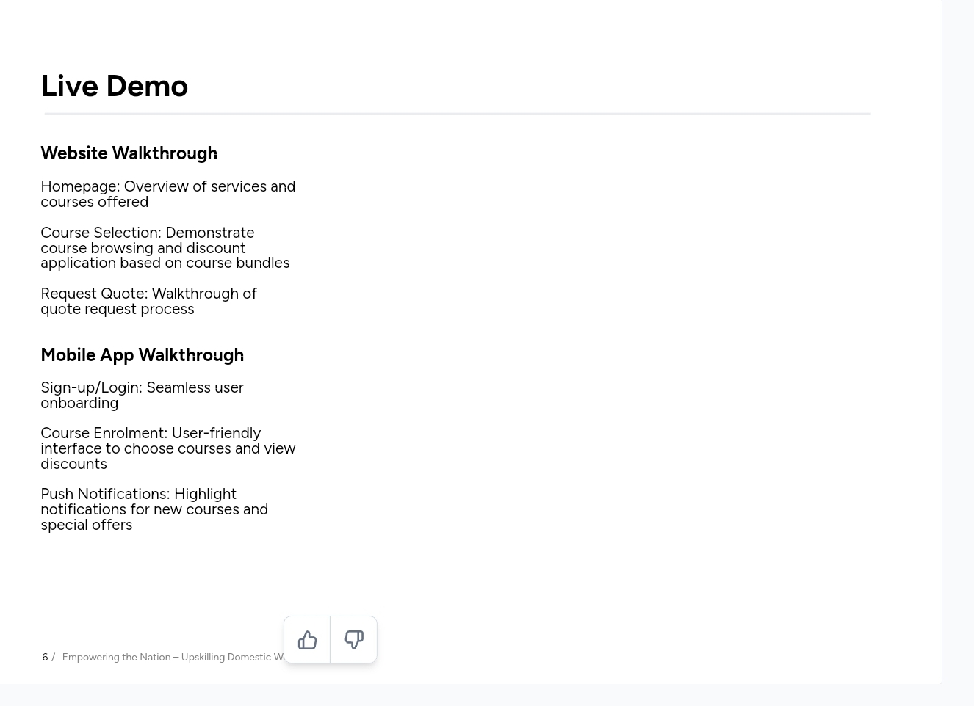

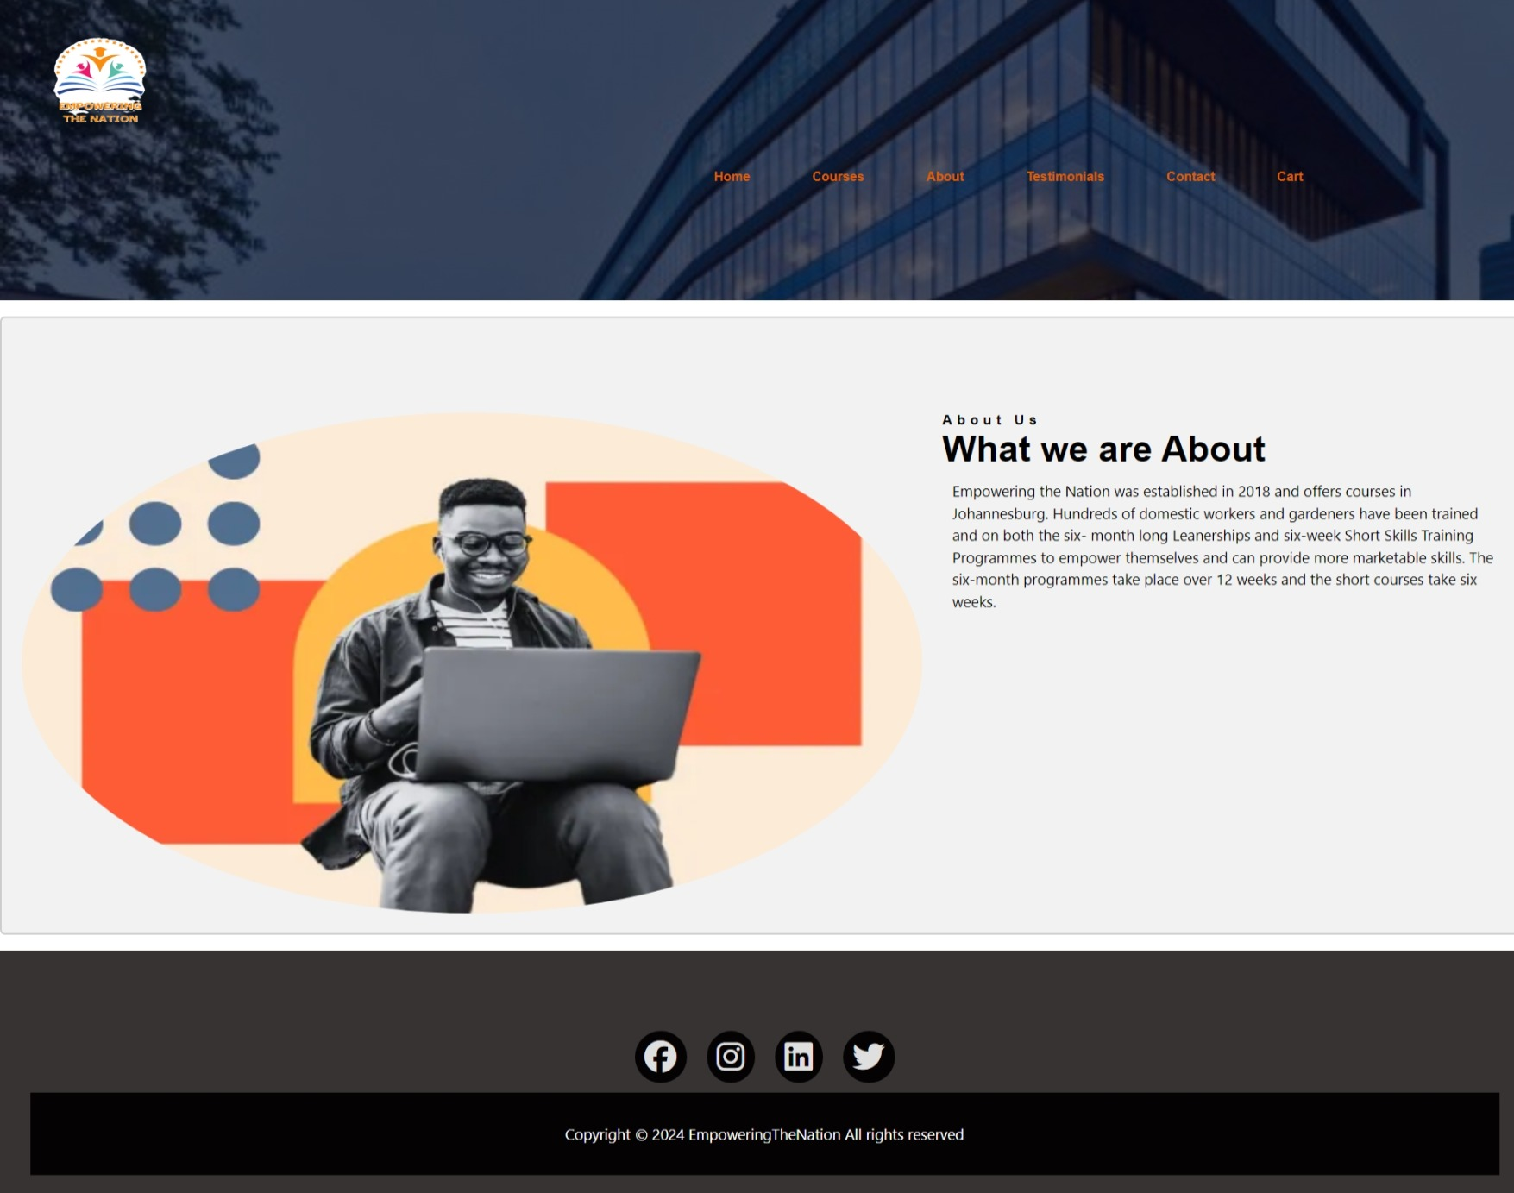
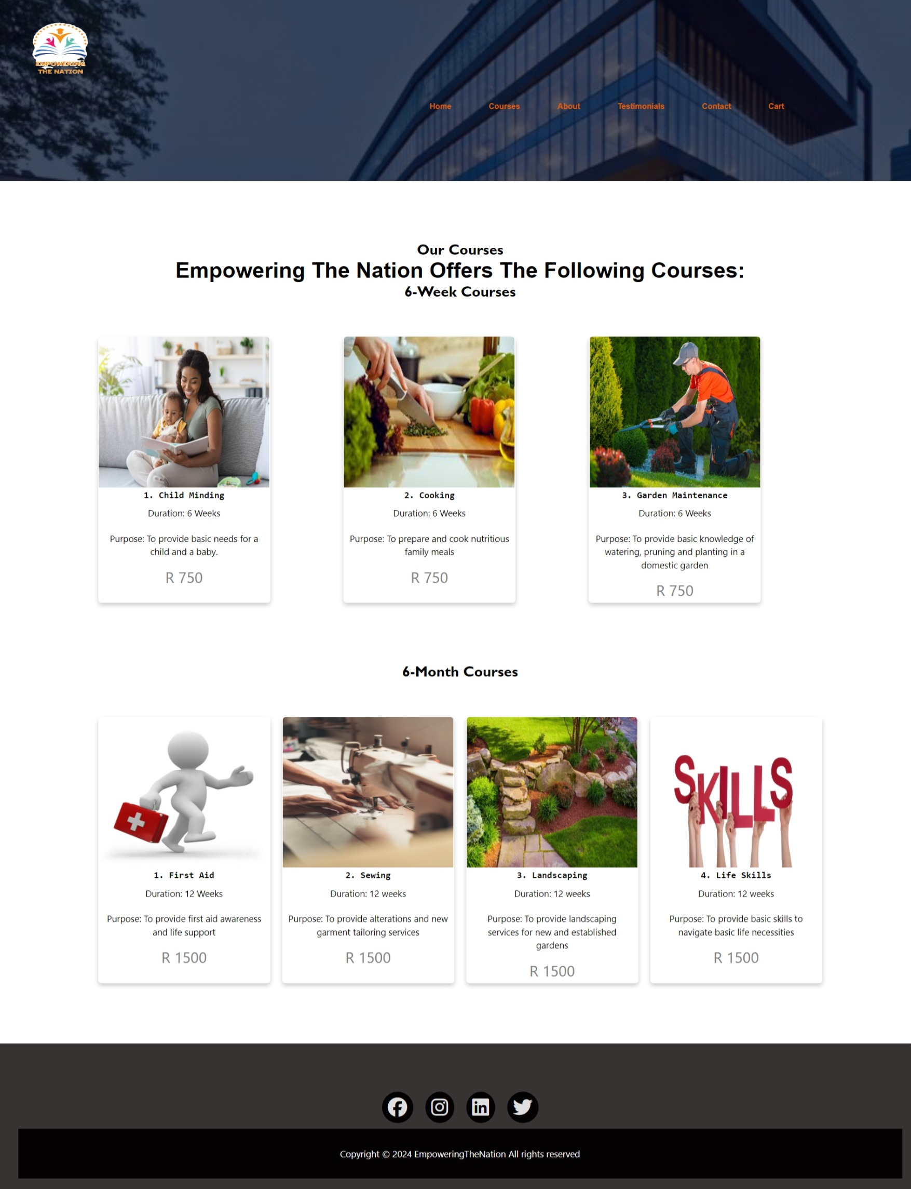





Slide 8

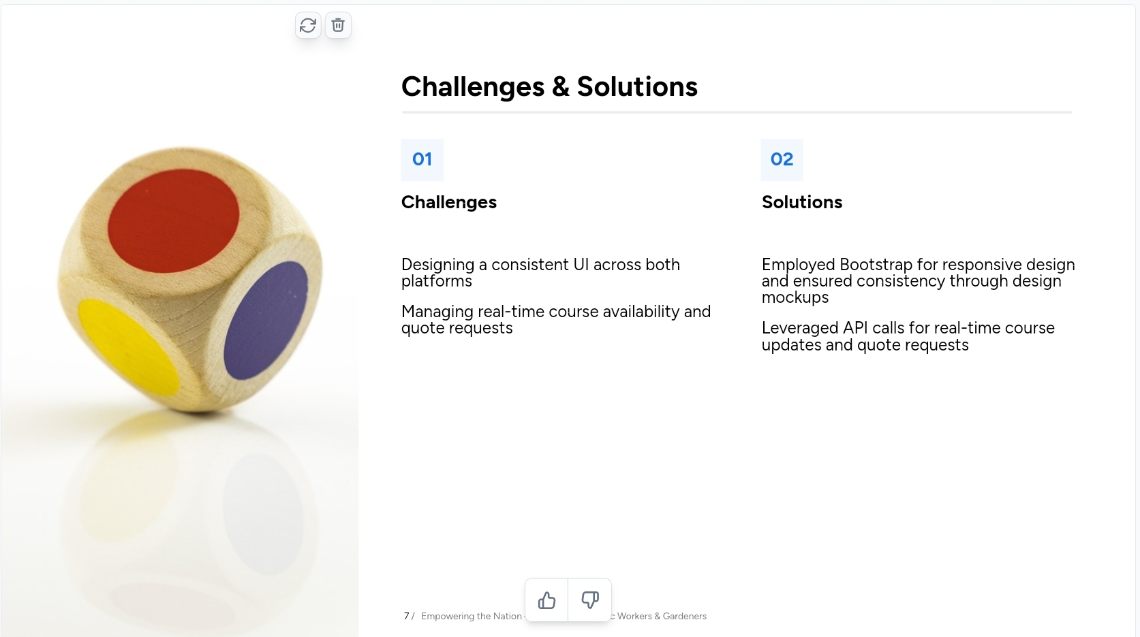

01
02

Slide 9
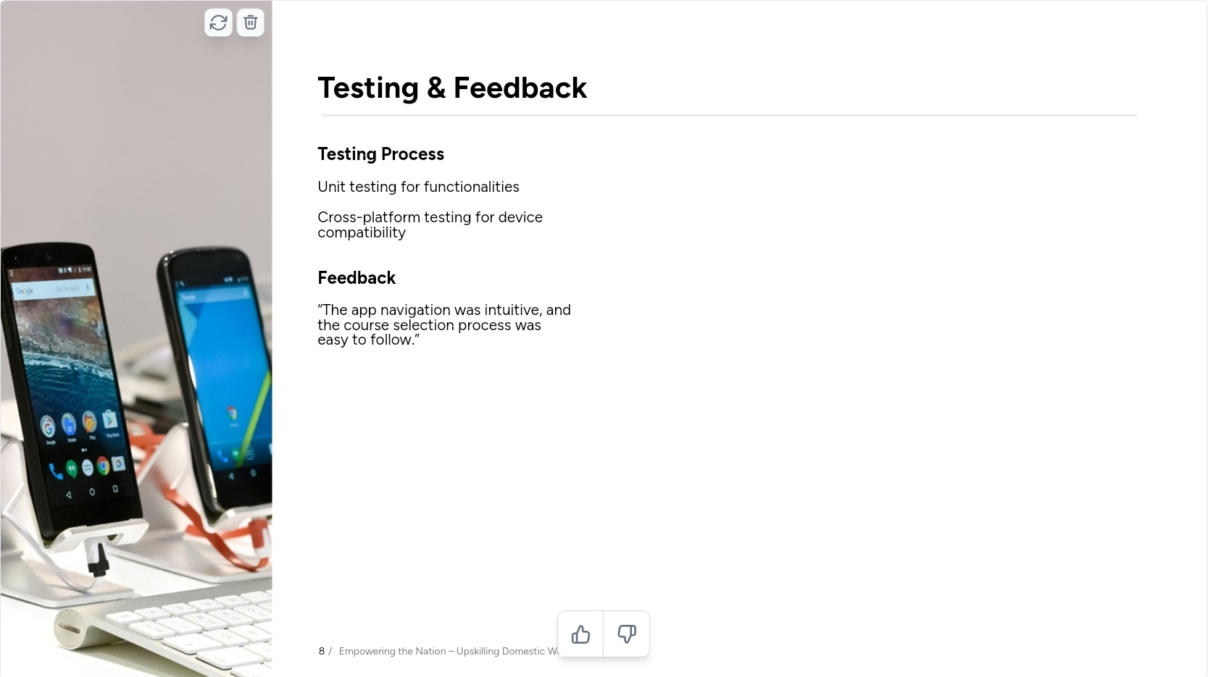




Slide 10
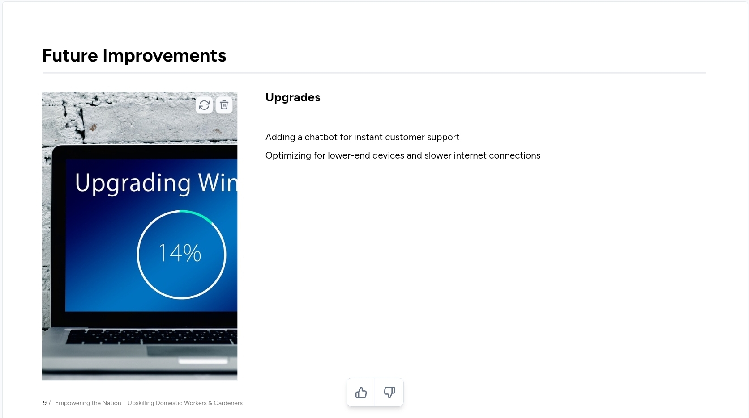


Adding a chatbot for instant customer support
Improving user access to additional social media platforms and implementing push notification functionality
Optimizing for lower-end devices and slower internet connections

Slide 11
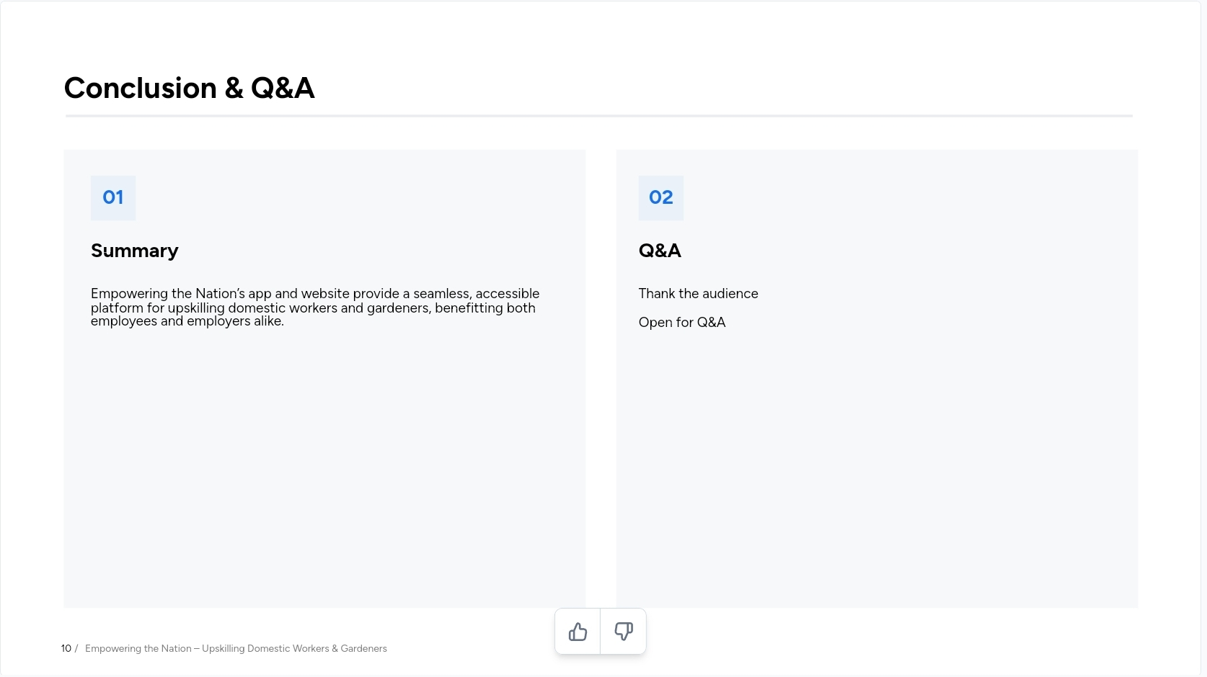


01
02

Slide 12
Reference List
Android Developers. (n.d.). Android Studio. Available at: https://developer.android.com/studio (Accessed: 17 August 2024).
Kotlin. (n.d.). Kotlin programming language. Available at: https://kotlinlang.org/ (Accessed: 11 August 2024).
Figma. (n.d.). Figma - The collaborative interface design tool. Available at: https://www.figma.com/ (Accessed: 8 August 2024).
Canva. (n.d.). Canva - Create stunning designs. Available at: https://www.canva.com/ (Accessed: 8 August 2024).

